Slide 1
IoT-Based Human Following Robot for Smart Campus Assistance
RoboTrackers | CIEL Kingston vibeAIthon 2025

Slide 2
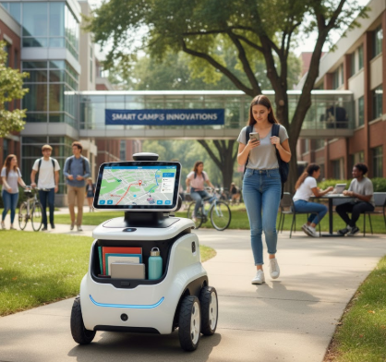

Slide 3
Problem Recap & Objective
The validated problem statement is that manual guidance or support in large campus environments is time-consuming, inefficient, and not scalable. This is a challenge because students, staff, and visitors often need assistance with navigating, carrying items, or following designated routes. There is a growing need for a smart, autonomous robot that can follow humans safely and provide live data via IoT for monitoring and optimization.
Key User Pain Points Addressed
It reduces manual effort and fatigue in following or carrying tasks.
It addresses the lack of real-time operational insight by providing real-time monitoring and IoT-enabled data for remote supervision.
It improves safety by maintaining a consistent distance and avoiding obstacles.
Prototype Objective and Expected Outcomes
The objective is to create an autonomous robot that follows a human while continuously monitoring distance and movement , with data sent to ThingSpeak for real-time visualization and analysis. The expected outcome is a robot that can accurately follow a target human without collisions , with its performance trackable remotely via ThingSpeak

Slide 4
Prototype Overview
The current prototype is functional and is designed to follow a human and transmit operational data.
Technology Stack
Controller: Arduino Uno for sensor processing and motor control.
Sensing: Ultrasonic Sensors (HC-SR04) detect the human and maintain a safe following distance.
IoT Connectivity: ESP8266 Wi-Fi Module sends real-time data to the cloud.
Platform: ThingSpeak is used for real-time data visualization and cloud monitoring.
Mobility: DC Motors with L298N Driver enable smooth and controlled movement.

Slide 5
Innovation
The approach is unique because it combines human-following robotics with IoT cloud monitoring. This integration allows for remote observation and data-driven improvements , offering a scalable platform for future AI or smart automation features. The estimated prototype cost is relatively low, between ₹5,000–₹10,000.

Slide 6
User Experience & Impact
Simple User Journey
A Warehouse staff (or campus staff) loads material onto the robot. The robot detects the staff using its ultrasonic sensors and autonomously follows them along a designated route, maintaining a safe distance. A supervisor can then track the robot's real-time distance, location, and operational status remotely via the ThingSpeak dashboard.
Next Steps for Scaling and Refining
The team has an established roadmap to continue development:
Next 30 Days: Optimize the following algorithm, improve sensor accuracy, and fine-tune motor control.
Next 90 Days: Integrate optional AI modules (like camera-based recognition) and test multi-environment adaptability.
The team is actively seeking Funding to purchase advanced sensors/camera modules and Mentorship to optimize the system and algorithms.

Slide 7
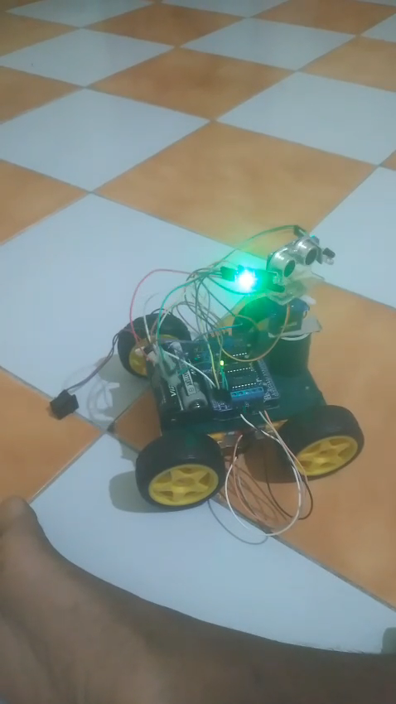
Screenshots & Wireframes

